Slide 1
DE Analysis with Time Interaction
Esther Zhou

Slide 2
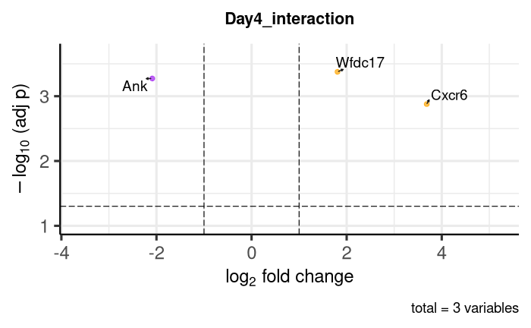
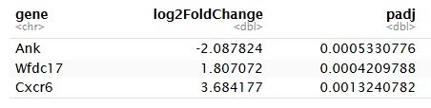
Day 4 Group-by-Time Interaction Volcano Plot
Model reference: Naive at −2 dpi.
Positive log₂FC indicates a stronger day 4 change in vaccinated mice relative to naive mice.
Negative log₂FC indicates a stronger day 4 change in naive mice relative to vaccinated mice.
Notes:
Positive interaction means: Vaccinated change from -2 to Day 4 is greater than Naive change from -2 to Day 4. Day 4-vs-baseline change is higher/more positive in Vaccinated than in Naive.
Negative interaction means: Vaccinated change from -2 to Day 4 is smaller than Naive change from -2 to Day 4.
The 4th gene’s p-adj > 0.05

Slide 3
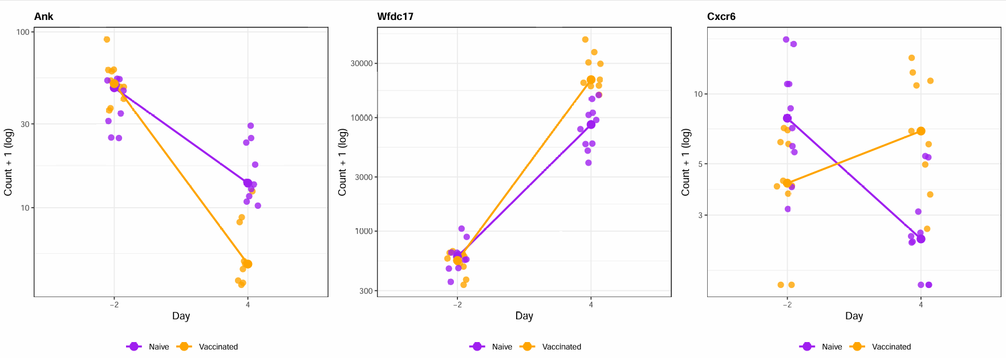
Significant Day 4 Group-by-Time Interactions
*The large dot on the line is the group median at each day.
Notes:
Y-axis shows DESeq2-normalized counts + 1 on a log10 scale; adding 1 allows zero-count samples to be displayed.
Ank shows a stronger Day 4 reduction in vaccinated mice compared with naive mice.
Wfdc17 increases strongly from baseline to Day 4 in both groups, but the increase is larger in the vaccinated group.

Slide 4
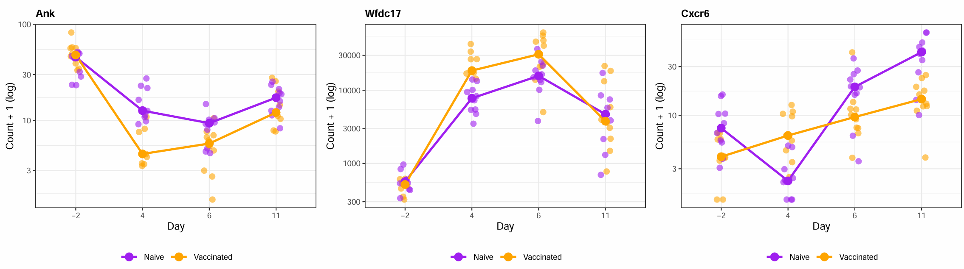
Expression Trajectories of Day 4 Interaction Genes
* Y-axis is shown on a log10 scale; 1 was added to allow zero counts to be plotted.

Slide 5
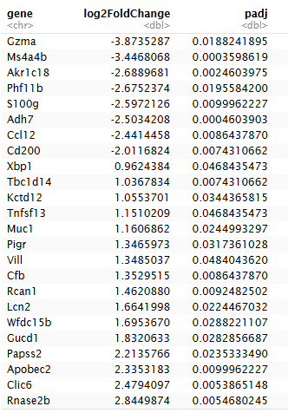
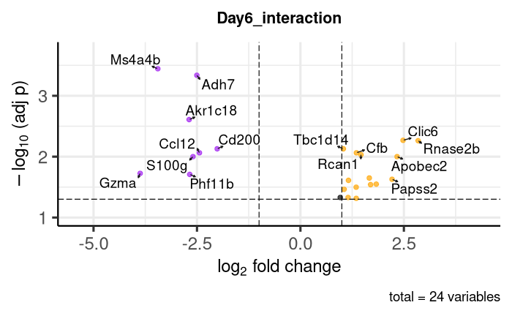
Day 6 Group-by-Time Interaction Volcano Plot
Model reference: Naive at −2 dpi.
Notes:
Sort by FC (negative first, then positive), then p-value. (plot top 4 up and down); 4*6 pdf/tiff file

Slide 6
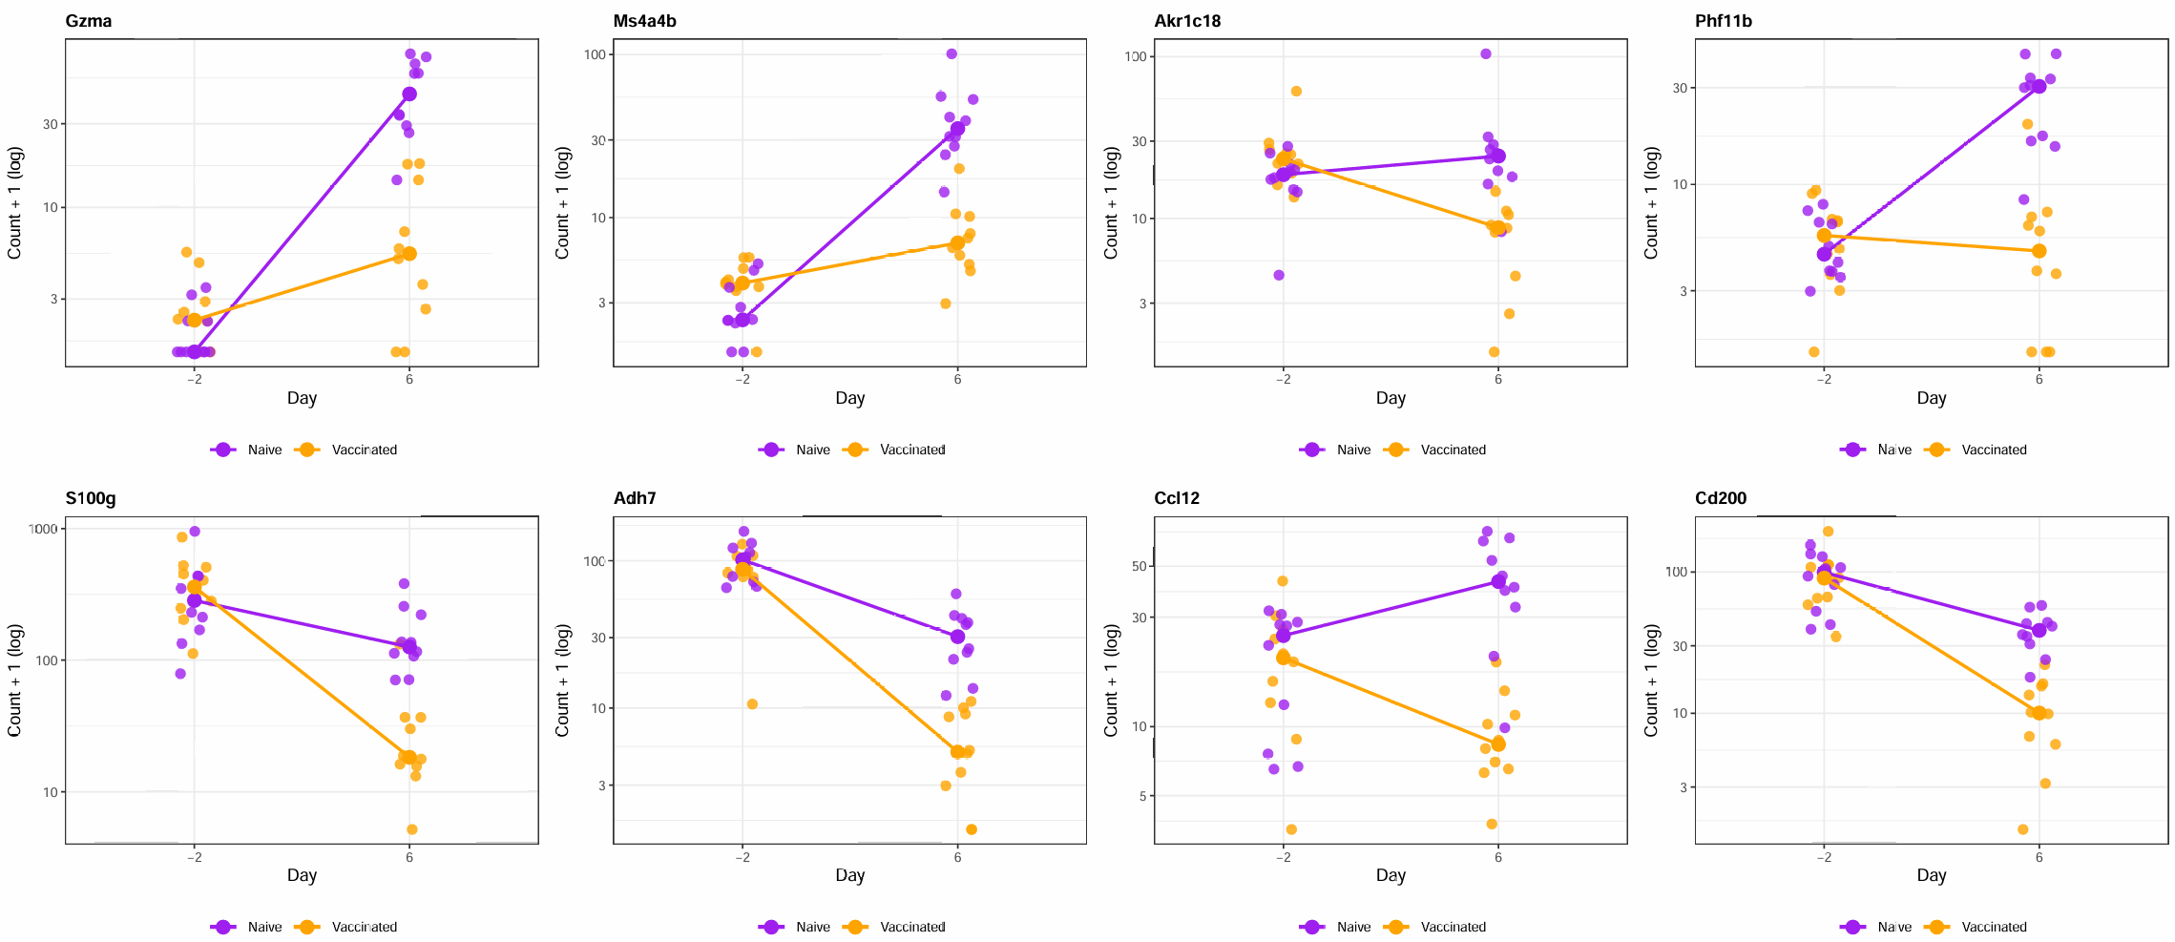
Significant Day 6 Group-by-Time Interactions Examples

Slide 7
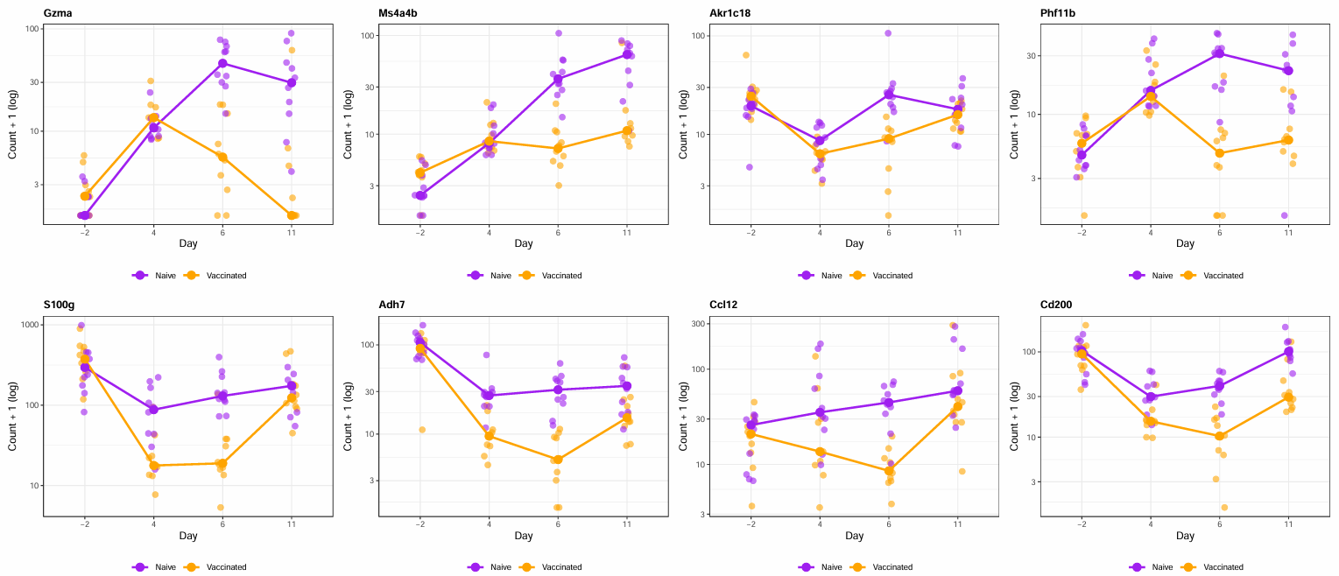
Expression Trajectories of Day 6 Interaction Genes

Slide 8
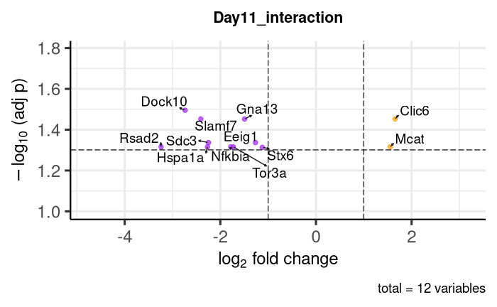
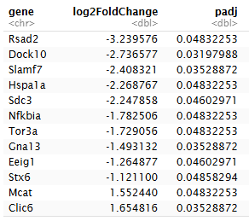
Day 11 Group-by-Time Interaction Volcano Plot
Model reference: Naive at −2 dpi.
Notes:
Cluster them by pattern?

Slide 9
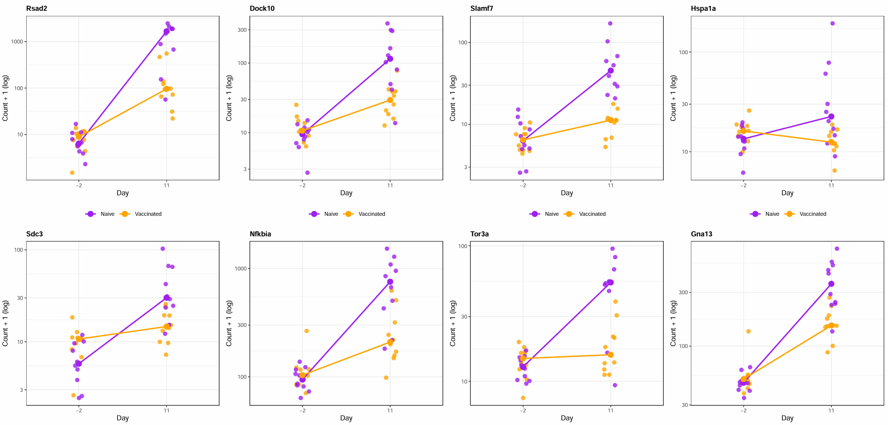
Significant Day 11 Group-by-Time Interactions Examples

Slide 10
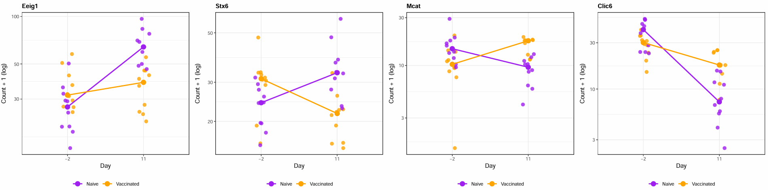
Significant Day 11 Group-by-Time Interactions Examples

Slide 11
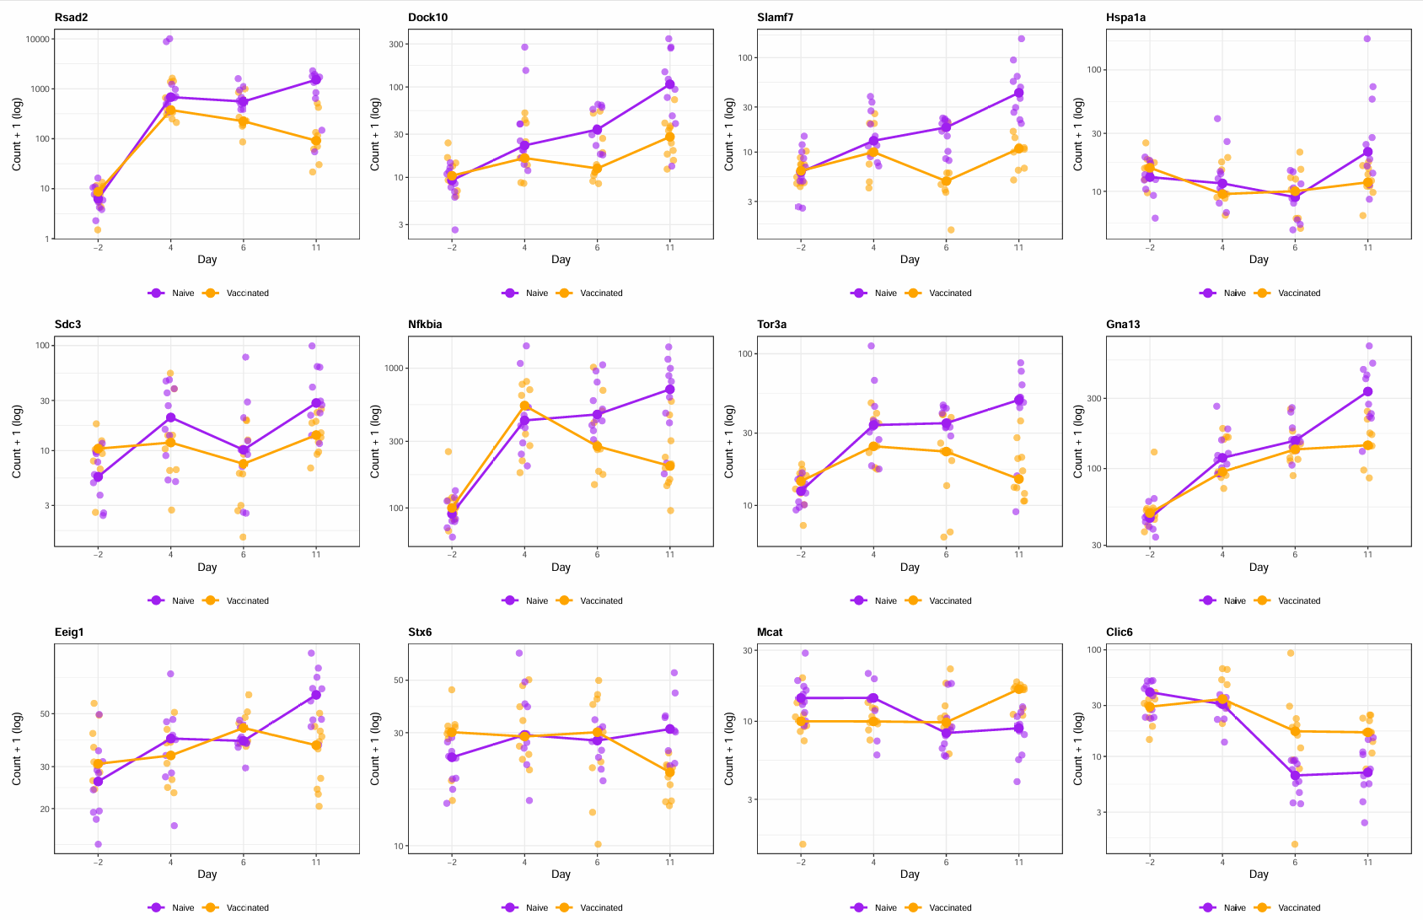

Slide 12
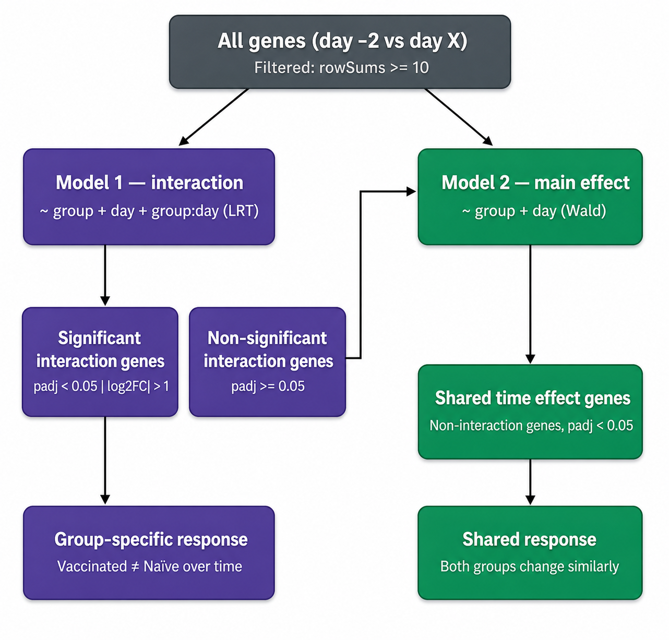
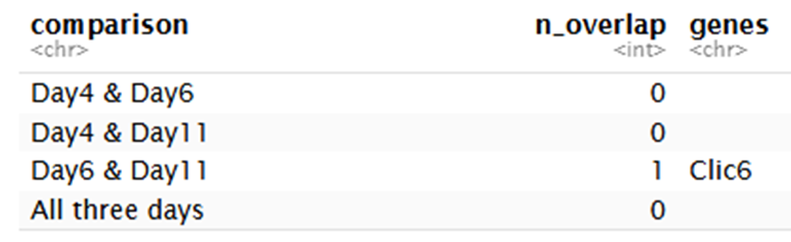
Two-Model Strategy for Time-Course DE Analysis

Slide 13
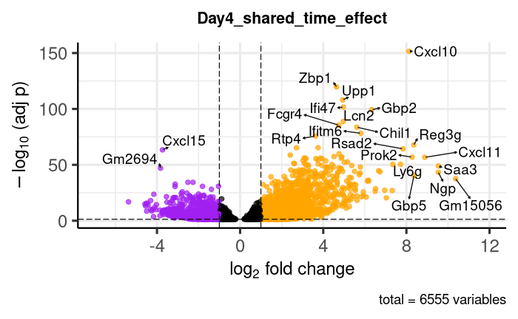
Day 4 Shared Time Effect Volcano Plot
Notes:
Among genes that did not show significant evidence of different temporal response between groups, 6,554 genes changed significantly from baseline to Day 4 across both groups.

Slide 14
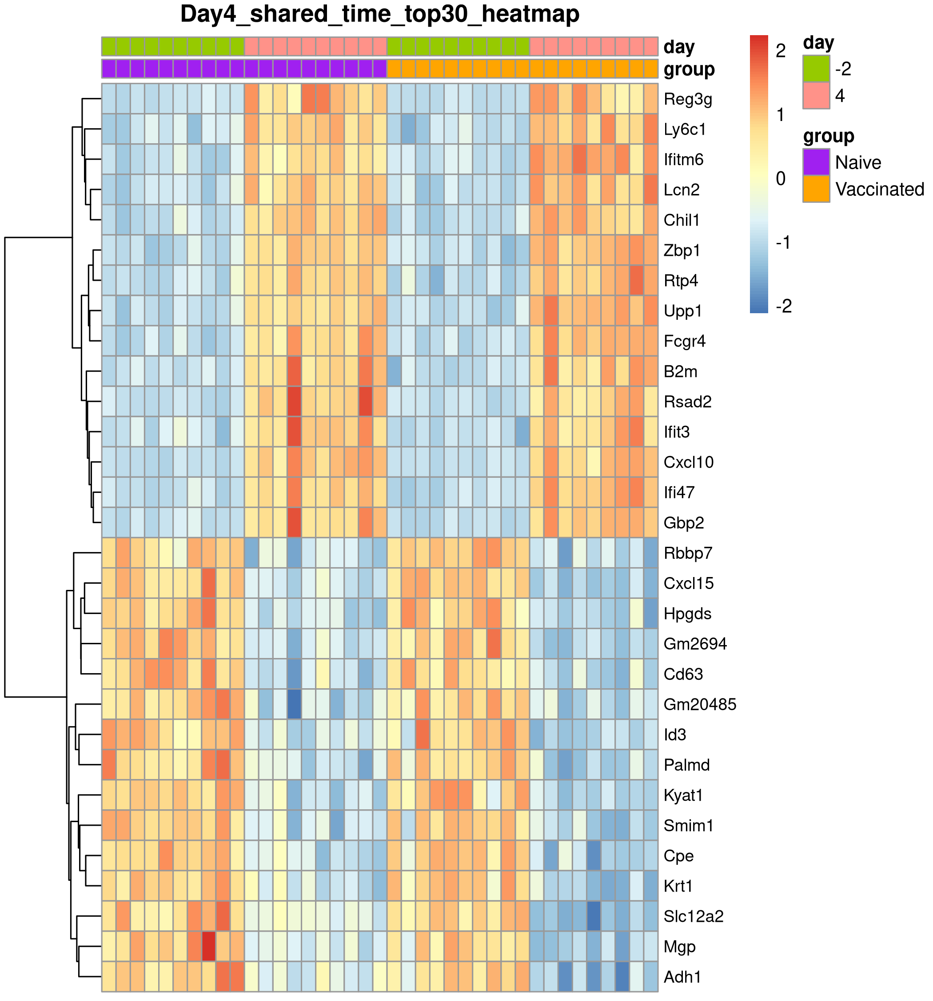
Day 4 Shared Time Effect: Top 15 Up- and Downregulated Genes

Slide 15
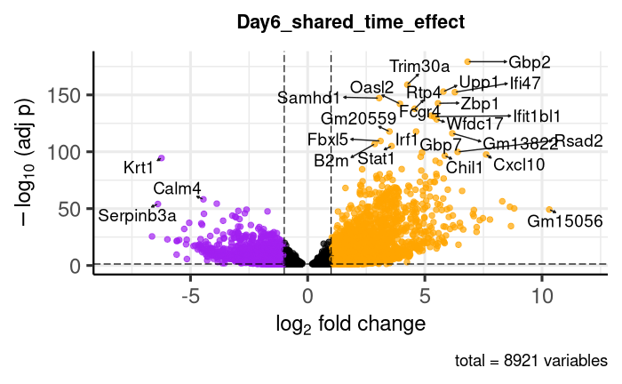
Day 6 Shared Time Effect Volcano Plot

Slide 16
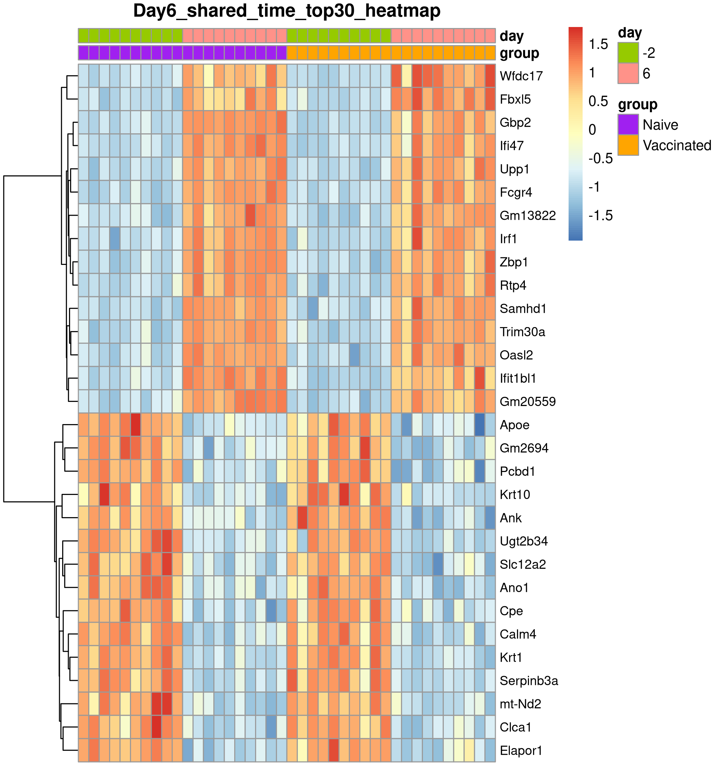
Day 6 Shared Time Effect: Top 15 Up- and Downregulated Genes

Slide 17
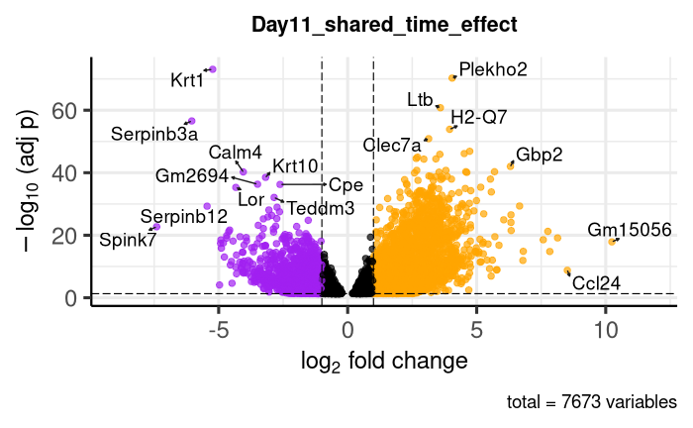
Day 11 Shared Time Effect Volcano Plot

Slide 18
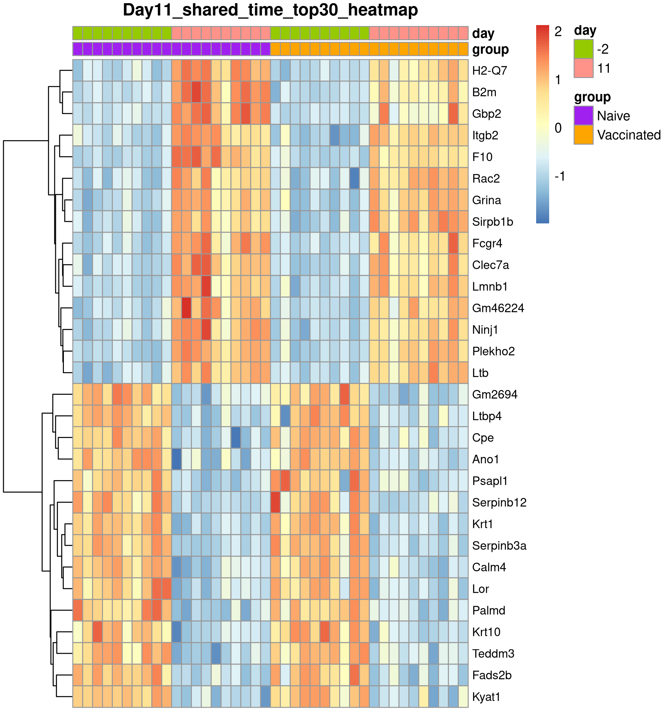
Day 11 Shared Time Effect: Top 15 Up- and Downregulated Genes

Slide 19
Suggestions?

Slide 20
Supplement

Slide 21
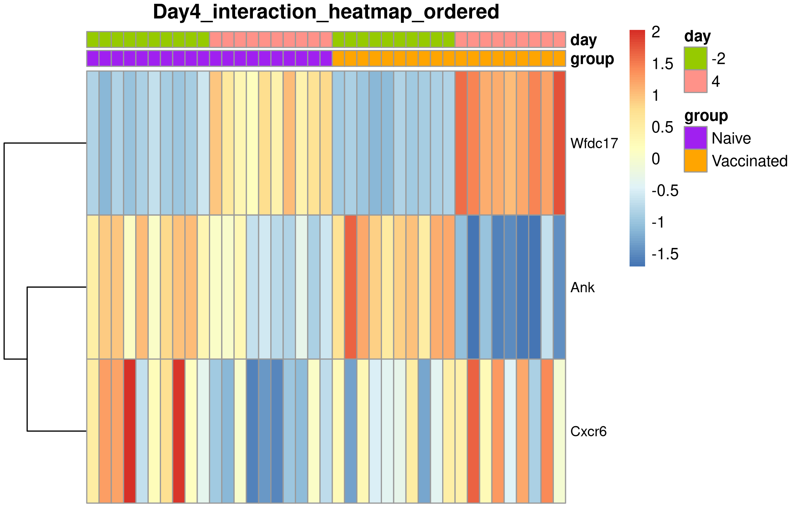
Examples of Significant Day 4 Group-by-Time Interactions
Notes:
Cxcr6 showed opposite temporal patterns between groups: expression decreased from baseline to Day 4 in naive mice, but increased from baseline to Day 4 in vaccinated mice.

Slide 22
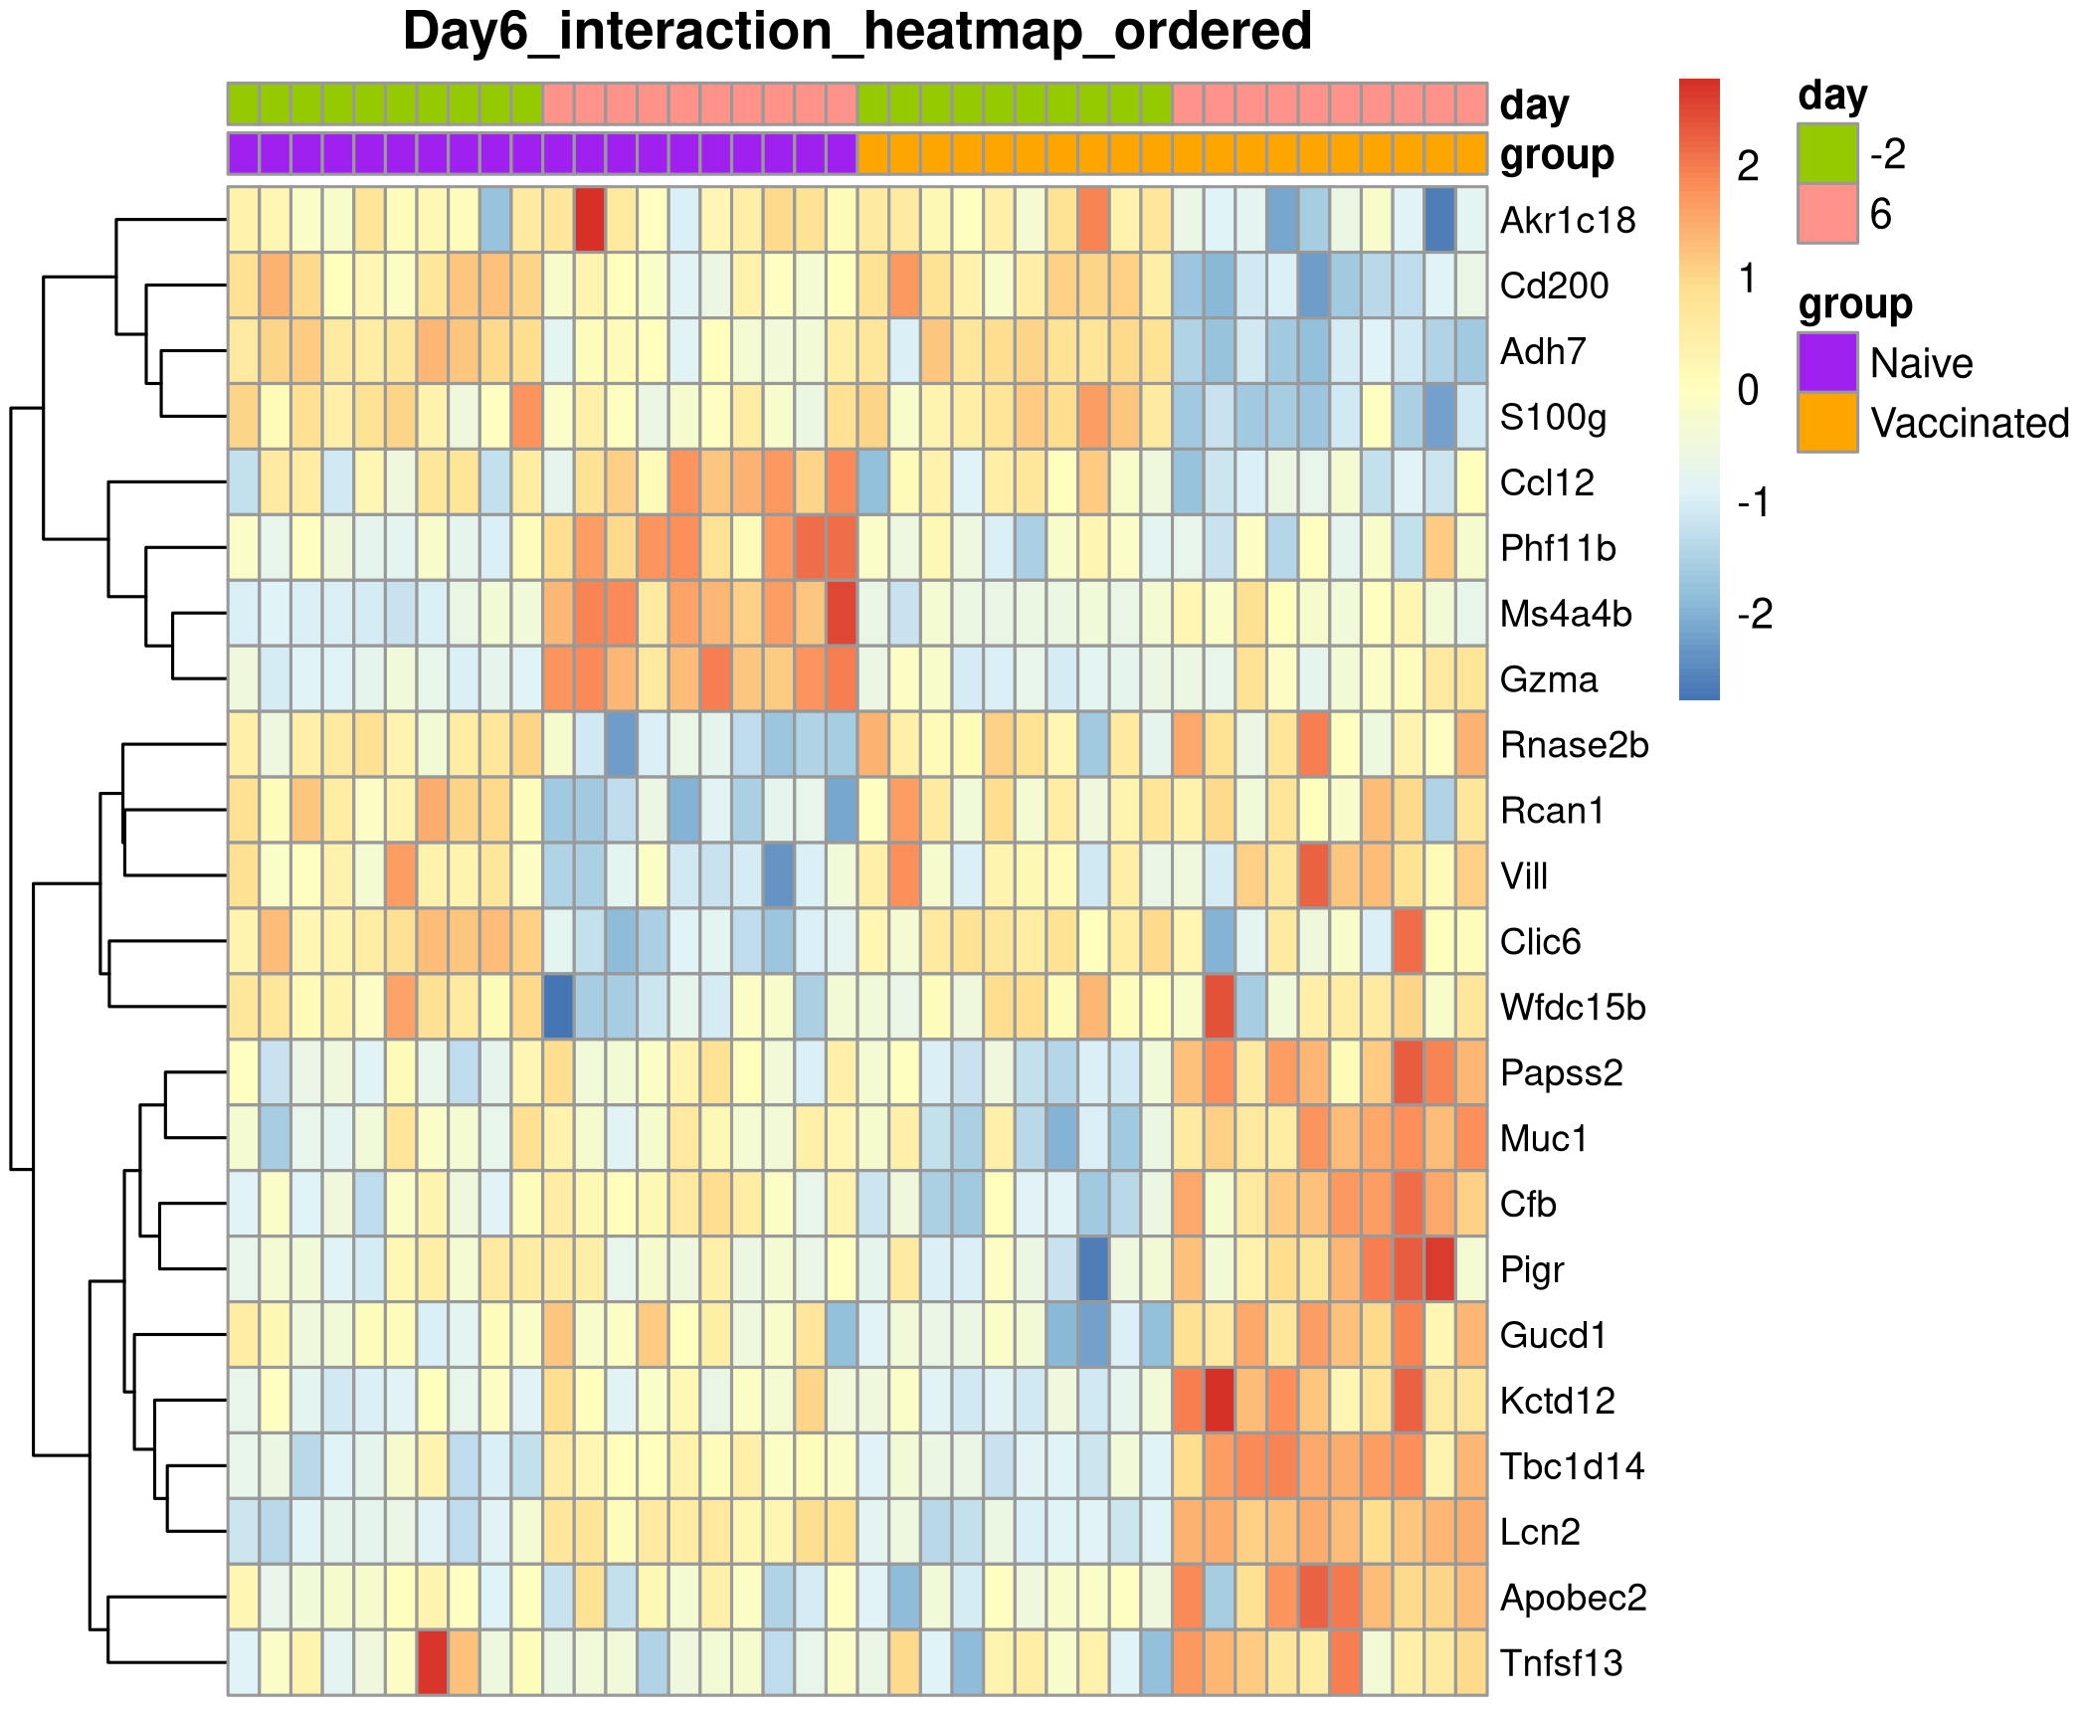
Day 6 Interaction Genes: Expression Heatmap
Notes:
remove

Slide 23
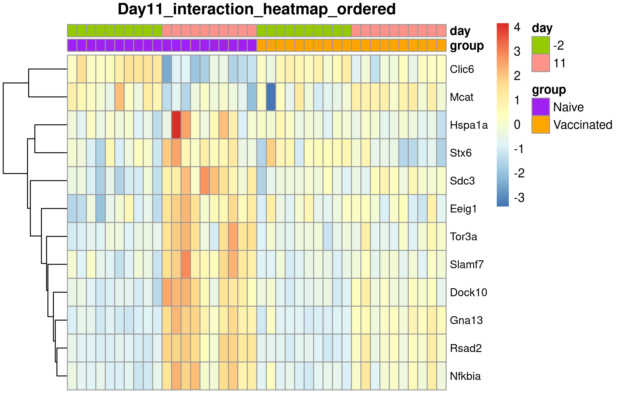
Day 11 Interaction Genes: Expression Heatmap

